Slide 1
Looped Through
Project Plan

Slide 2
Looped Through – The Idea!
Looped Through is a story based game using the idea of restarting days, and solving puzzles using mechanics like recurring days but with picked up items from previous version of that day and making different decisions to get through the story within the quickest possible time…
The game is a single page web app which draws information from a Web API and uses various coding tools

Slide 3

Looped Through – Key Stakeholders
Business Experts
People with good knowledge / experience in required industry, who can give insight and be able feedback about app to help make the app useable and solve solution the app aims to fix
Project Manager
Oversees the whole development project helping with requirements and provides guidance on possible restrictions with development
Developers
Build the software based on required requirements using technical knowledge
Testers
Test software functions feeding information back to the developers
Users
People who may buy/use software can provide insight into UX and how they envision the App to work
Backend Users / Admins
Can provide information on what they require to be able to update and add new materials Service customer requirements
Director / Project Sponsor Person who owns the project and provides useful information and resources

Slide 4
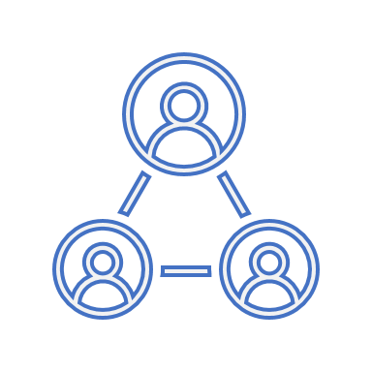



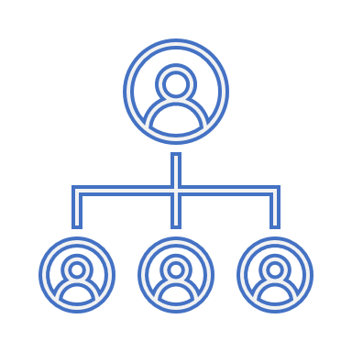



Looped THrough – Stakeholder Management
Role | Who | Expectation | Interest | Influence | Matrix | Comm Method | Frequency
Sponsor | Mx X | App design which solves targeted problems |  |  |  | Email | Weekly
Project Manager | Mx Y | Fully documented requirements completed |  |  |  | Calls / Email / Teams | Tues + Thurs
Business Expert | Mr Z | Completed requirements based on expertise |  |  |  | Email | Weekly
Dev Team | Ms IO | Understand Requirements and build app |  |  |  | Calls / Email / Teams | Daily
Tester | Mr Abc | Ensure App works to requirements |  |  |  | Email / Calls | Weds + Fri
Users | Joe Bloggs | Working App which helps them |  |  |  | Email | On release of new version

Slide 5
Looped THrough – Gathering Requirements
Survey Method
Create a survey which asks probing questions. This survey can blanket all stakeholders.
The survey can uncover requirements which the Stakeholder may not be fully aware they require or disclose by asking the right questions.

Slide 6
Looped Through - Requirements
ID | Title | Description | Acceptance | Priority | Functional? | Moscow
001 | Game Story Traversal | Ability to start and play through to completion | System should allow user to play through to completion | High | Functional | Must Have
002 | Play background music | Gives the game atmosphere by playing music | Play music as you enter game menu, then change track in gameplay | High | Functional | Must Have
003 | Change picture based on the scene within game | Every time you change a scene it changes the picture for that scene | Seeing the image change | High | Functional | Must Have
004 | Finish game | The game should have a win state | The player should be prompted with state so the game ends | High | Functional | Must Have
006 | Slick App | App should load and pull data within suitable time frames | Pull data shouldn’t take more than a second | Low | Non-Functional | Could Have
007 | Share a top score | Be able to email friend your top score to boast | Email success | Low | Functional | Could have
008 | Make it nice and simple | Buttons should be where I expect them to be and designed so I understand what they will do | User to be able to use app with minimal training /experience | High | Non-Functional | Should Have
009 | Link it up | Have Links to supermarkets where they can order food | Links correctly navigate to supermarkets | Medium | Functional | Should Have
010 | Multiple histories | Multiple history locations with each time loop at random | Creates new perspective based on Loop | Low | Functional | Won't Have

Slide 7
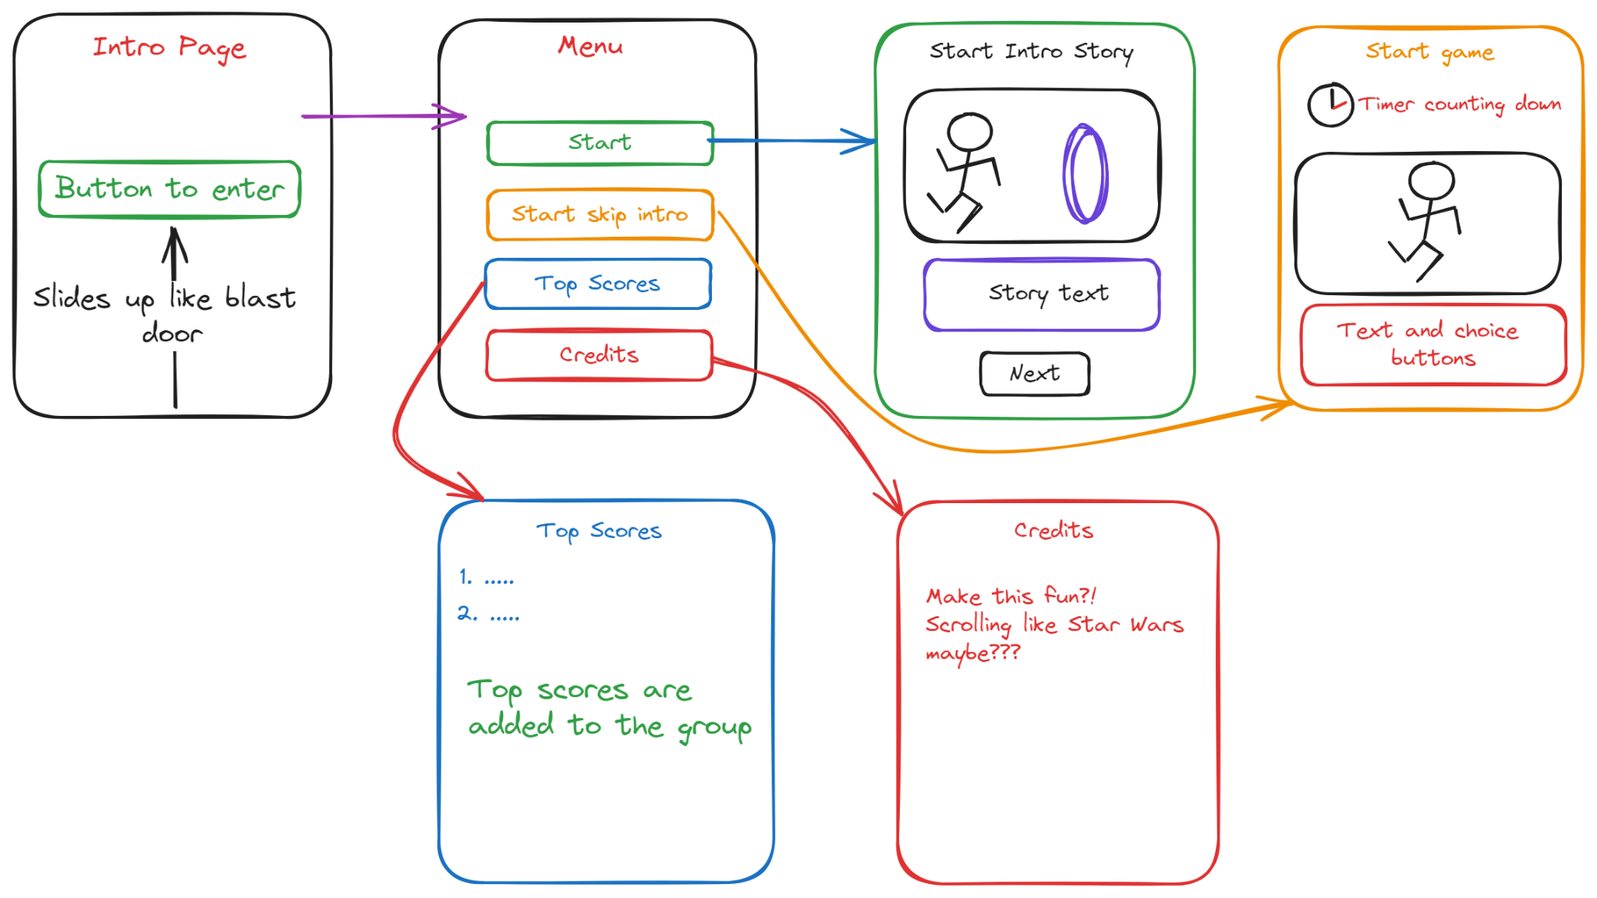
Wire Frames

Slide 8
Looped THrough – Dependencies
Google Fonts - https://fonts.google.com/
React.js - https://react.dev/
More to come…

Slide 9
Looped Through – Dev + Deploy Approach
Development Approach – Agile
Allows Dev team to make small updates rapidly to allow users MVP and then have app grow as more features can become available
Deployment Approach – Blue / Green
Allows users to have App which is stable while Dev can work on new features and test before setting live

Slide 10
Looped Through – Breaking down development
Stories
As a user, I want to choose my own path through game – 5 Points
As a user, I want to be able read a story – 8 Points
As a user, I to be able to finish the game – 3 Points
As a user, I want to be able to see if I beat the top score – 5 Points
As a user, I want to see who built the game and other credits – 2 Points
As a user, I want to hear music as I play the game – 2 Points
As admin, I want to see images as the story continues – 8 Points

Slide 11
Looped Through – Time-Line

